Slide 1



Data Wrangling: Organising and Enabling Data ©
Dr Diarmuid McDonnell & Prof. Vernon Gayle
AQMEN
University of Edinburgh
March 2019
© Diarmuid McDonnell, Vernon Gayle

Slide 2
Welcome
Notes:
Cover the preliminaries:
Timings
Programme
Fire drills

Slide 3
Why are we here today?
U.K. Industrial Strategy aims to utilise big data to improve economic performance and increase productivity.
Major barrier is the lack of a suitably trained workforce.
U.K. social science stakeholders (e.g. ESRC, Nuffield) believe this discipline can make a major contribution to Industrial Strategy.

Slide 4
Why this type of training?
“Many organizations can barely find a way to use their R/Python programmers on reasonable datasets.”
“The piece missing from the data science movement right now is really simple: intelligent application of data science tools.”
https://www.linkedin.com/pulse/data-science-dead-5-years-less-justin-b-dickerson-phd-mba-pstat- accessed 16.07.2018.

Slide 5
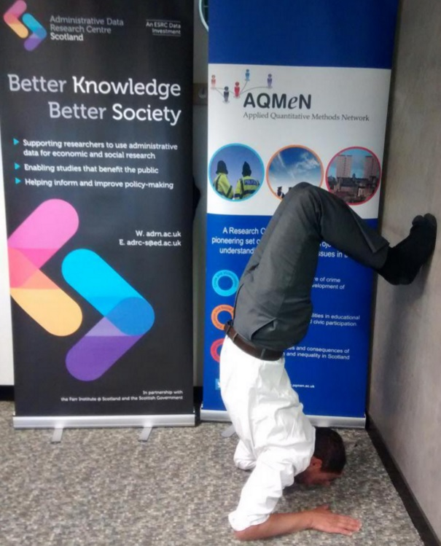


Slide 6
What is the social science contribution?
Data Science ≠ Computer Science
Big Data ≈ Small Data
QM Social Scientists = Data Literate

Slide 7
Data Wrangling

Slide 8
The Workflow
Research Idea
Proposal
Ethical Approval
Data Collection
Exploratory Data Analysis
Formal Data Analysis
Presentations
Publications
Archiving

Slide 9
A Thought Experiment (Be honest…)
Have you ever lost a file?
Have you ever wondered if you have deleted a file?
Have you and a colleague ever been working on different versions of a file?

Slide 10
Be honest…
Have you ever struggled to identify which data file is the correct one?
chapter1_2014.dat
chap1_2014.dat

Slide 11
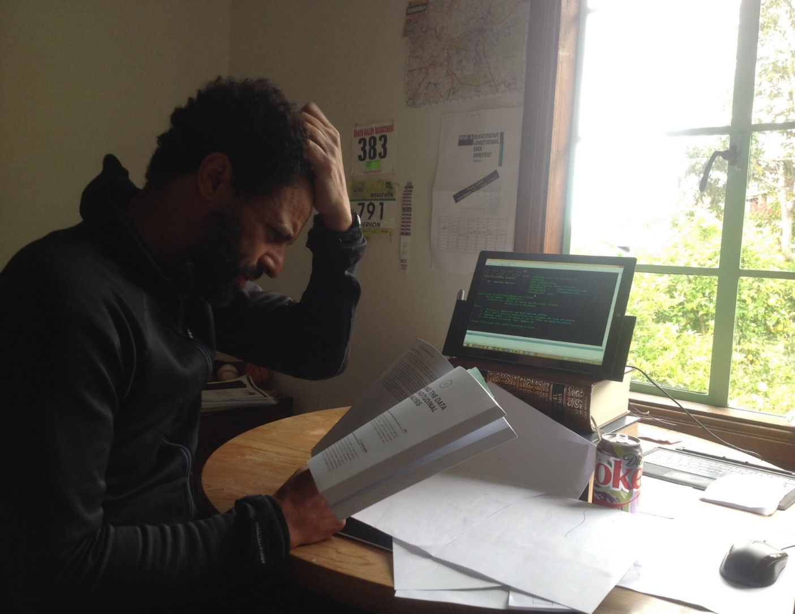

Slide 12
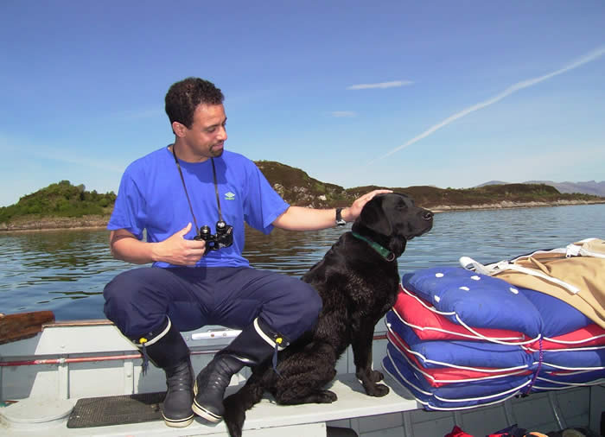

Slide 13
The Workflow
Planning, organising and documenting work
This includes…
Cleaning data
Analysing data
Presenting results
Backing up and archiving material

Slide 14
The Workflow
Workflow should be planned and carefully orchestrated
Workflow MUST not be adhoc
(e.g. piece-meal, developed as a reaction to mistakes etc.)

Slide 15
The Workflow
Better supporting YOU and what YOU DO
Not changing you into something YOU ARE NOT

Slide 16
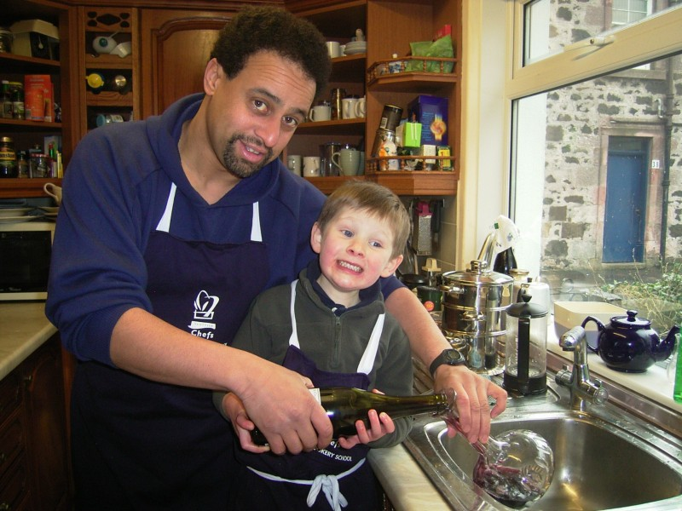
Shopping without a list? Cooking with a list?

Slide 17
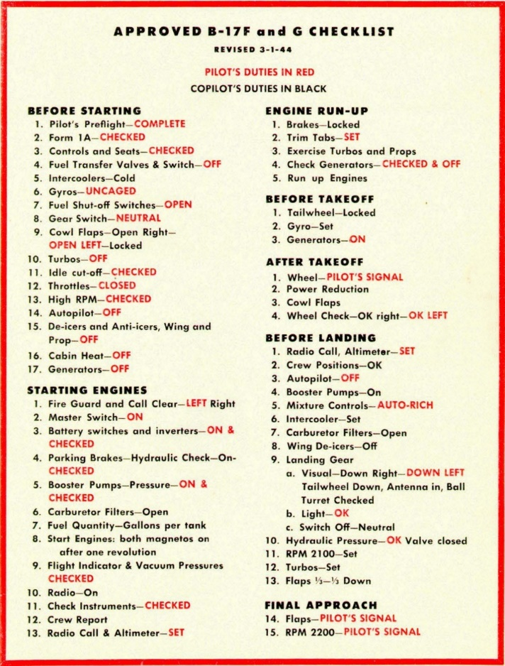
In the late 1930s, military aviators in the American Army and Navy began using aviation checklists. Checklist became part of a new paradigm for how to fly, which consisted of
• Elaborate standardized procedures for many activities
• Checklists to ensure all critical steps had been done
• Quantitative tables and formulas that specified the best settings, under different conditions, for speed, engine RPM, gasoline/air mixture, engine cooling, and many other parameters.
This new paradigm (Standard Procedure Flying) had a major influence on reducing aviation accidents and increasing military effectiveness during World War II, particularly because of the rapidly increasing complexity of military aircraft, and the huge number of new pilots.
Despite the benefits of Standard Procedure Flying for both safety and efficiency, by the end of WWII only a few air forces had fully embraced it
Roger Bohn http://www.vs29.org/Links/NATOPS/SOP-bohn-2013-1.pdf

Slide 18
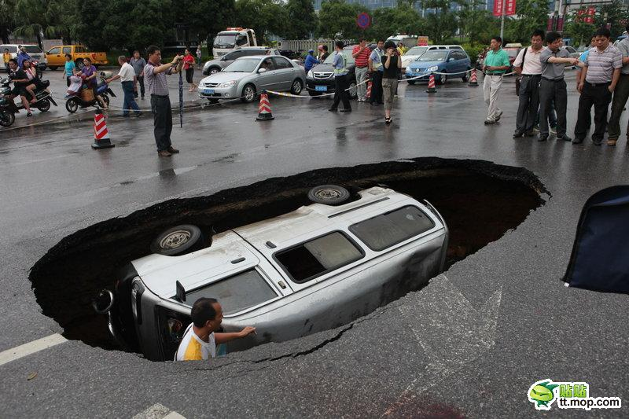
The Platinum Standard

Slide 19
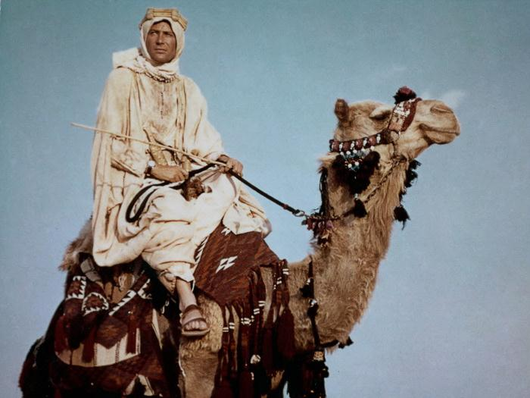
The Four Pillars
of Wisdom

Slide 20

A Planned Workflow Has Benefits
Progamming
Efficiency
Transparency
Accuracy
Reproducibility

Slide 21
Four Pillars of Wisdom
Accuracy
minimising information loss and errors in analyses and output
Programming Efficiency
automation, maximising features in software
Transparency
showing what you did, why, when, how
Reproducibility
same results every time whoever or wherever
editing, rewriting reports or re-submission of papers

Slide 22
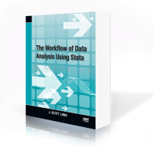
J. Scott Long has posted a really good pdf version of a talk on the workflow http://www.ihrp.uic.edu/files/Workflow%20Slides%20JSLong%20110410.pdf

Slide 23
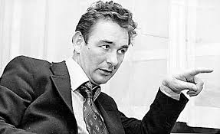
The best habit that you can get into
is to get into good habits!

Slide 24
The Workflow
Drukker’s dictum: Never type anything that you can obtain from a saved result
My dictum (Gayle’s dictum):
You can’t be too fit or have too many publications
However…

Slide 25
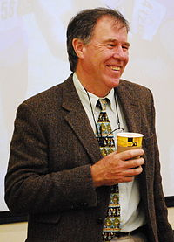

500+ scientific publications in peer reviewed journals (15,000+ citations and an H-index of 66)
Has run more than 70 marathon and ultra-marathon races, including seven 90km Comrades Marathons and fifteen 56km Two Oceans Marathons
http://www.essm.uct.ac.za/ESSM/Tim_Noakes
Over 20 Ultra Marathons including the Western States 100 mile race
1480 citations since 2011
https://www.stat.berkeley.edu/~stark/index.html

Slide 26
Long’s Law
It is always easier to document today than it is tomorrow!
Corollary 1:
Nobody likes to write documentation
Corollary 2:
Nobody every regrets having written documentation

Slide 27

Long’s Law
Has anyone in the history of data analysis ever said
“these files are too well documented”

Slide 28
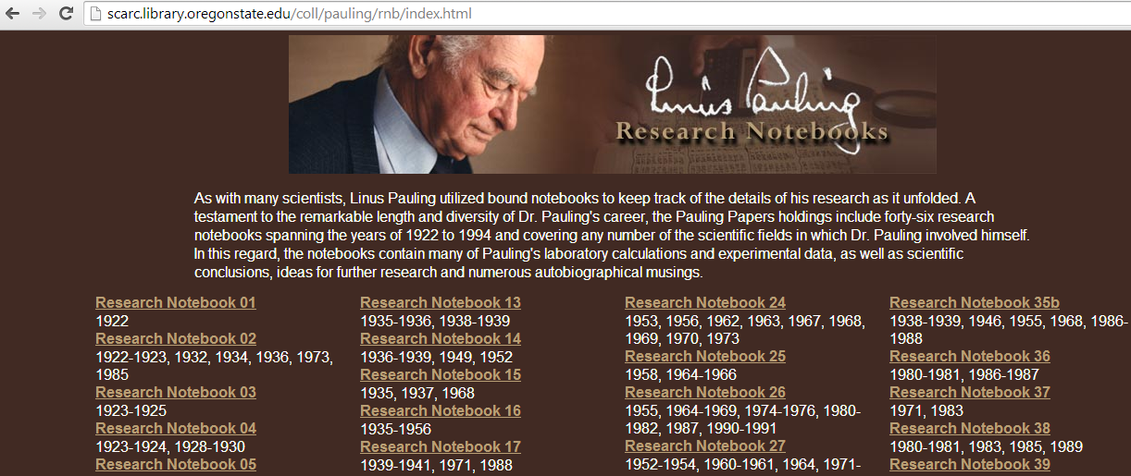

Slide 29
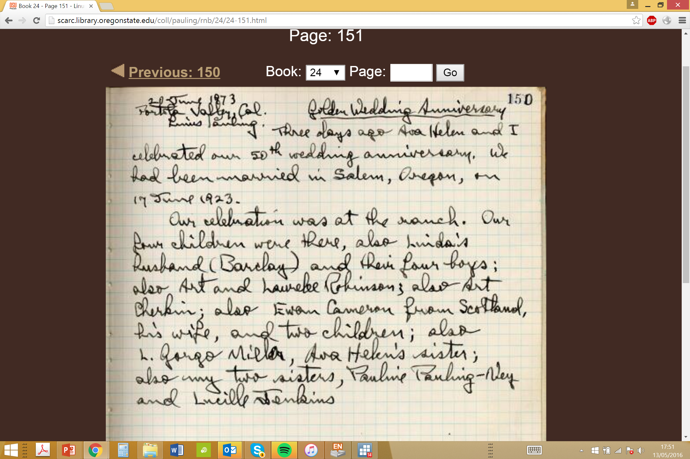

Slide 30
Improving the workflow with a modest amount of effort
The less experience you have the better
start from the very beginning

Slide 31
ALL SERIOUS WORK MUST BE REPRODUCIBLE!
There MUST be an audit trail

Slide 32
Why is it all so difficult?
Social science data tends to come in messy formats
Administrative data often is even more complex in nature than social survey data

Slide 33
Minor decisions have major consequences…
Which cases?
Which variables?
How to code (e.g. education)?
How to recode?
Where do I truncate?

Slide 34
Minor decisions have major consequences…
Which cases?
Which variables?
How to code (e.g. education)?
How to recode?
Where do I truncate?
Can I trace these decisions in my audit trail?

Slide 35
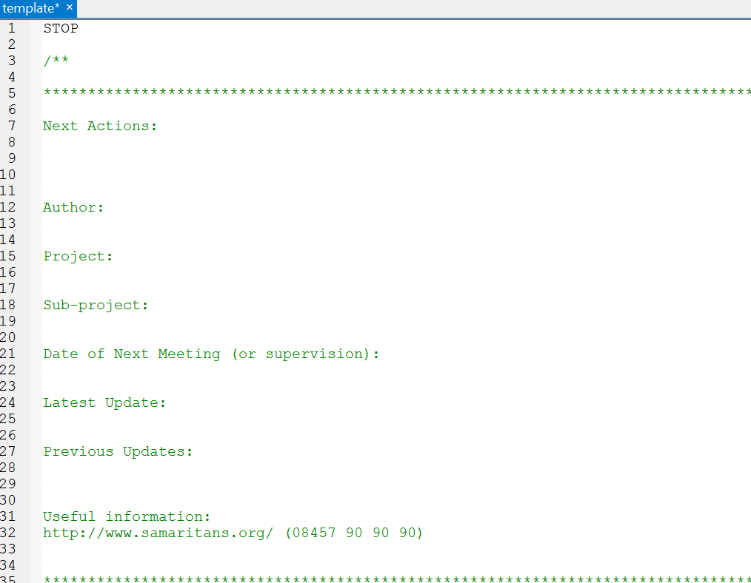

Slide 36
File Naming Protocols
File Name =
name_date_depositor's initials_version_type

Slide 37
File Naming Protocols
File Name = name_date_depositor's initials_version_type
Therefore bhpsaindresp_20140506_vg_v1.dta
Would be a
a.. The British Household Panel Survey File “aindresp”
b.. Deposited on 6th May 2014
c.. Deposited by vg (Vernon Gayle)
d.. Version v1
e.. File type (e.g. a Stata .dta file)

Slide 38
Other seemingly small issues such as ‘Directory Structures’ and ‘Variable Naming Conventions’ are similarly worth thinking about!

Slide 39
Why is it all so difficult?
Poor discipline and insufficient documentation

Slide 40
Juila, Python and R almost spell JuPyteR
https://jupyter.org/

Slide 42
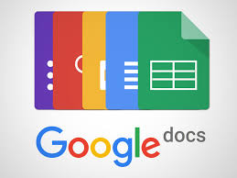








Slide 43
Workshop

Slide 44
R
Growing in popularity (e.g. data science, statistics, science etc.)
Popular with statisticians
Free (open source)
Difficult to learn
Development and support is not commercial
Help resources are under-developed

Slide 45
Programme
Mix of talks and self-directed practical activities.
Data Wrangling challenge (“Hackathon”).
Tutor and peer support.
Use of a variety of data sets, especially messy administrative records.

Slide 46
Top tips
Ask plenty of questions.
Take your time.
Complete as many of the tasks and exercises, and answer as many of the questions as you can.
Annotate your work.
Be positive.

Slide 47

Estimating Work Time…

Slide 48
Good Luck
Our aim is to equip you, as rapidly and painlessly as possible, with a proficiency in data wrangling using R.
We think it is an ambitious yet achievable goal.
Them: “Are you any good at data wrangling?”
You: “Yes, yes I am.”

